Slide 1
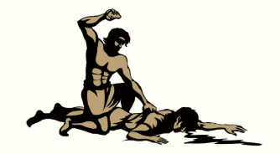
Please Don’t Crucify Your Brother
When He Sins
I John 1:1-10
Notes:
Eddie Williams ~ August 10, 2025 Eloy (AM)

Slide 2
I John 1:1-10 (CSB)
¹ What was from the beginning, what we have heard, what we have seen with our eyes, what we have observed and have touched with our hands, concerning the word of life—
² that life was revealed, and we have seen it

Slide 3
I John 1:1-10 (CSB)
and we testify and declare to you the eternal life that was with the Father and was revealed to us—
³ what we have seen and heard we also declare to you, so that you may also have fellowship with us;

Slide 4
I John 1:1-10 (CSB)
and indeed our fellowship is with the Father and with his Son Jesus Christ.
⁴ We are writing these things so that our joy may be complete. ⁵ This is the message we have heard from him and declare to you:

Slide 5
I John 1:1-10 (CSB)
God is light, and there is absolutely no darkness in him. ⁶ If we say, “We have fellowship with him,” and yet we walk in darkness, we are lying and are not practicing the truth. ⁷ If we walk in the light as he himself is in the light, we have fellowship with one another,

Slide 6
I John 1:1-10 (CSB)
and the blood of Jesus his Son cleanses us from all sin.
⁸ If we say, “We have no sin,” we are deceiving ourselves, and the truth is not in us.

Slide 7
I John 1:1-10 (CSB)
⁹ If we confess our sins, he is faithful and righteous to forgive us our sins and to cleanse us from all unrighteousness.
¹⁰ If we say, “We have not sinned,” we make him a liar, and his word is not in us.

Slide 8
What Does the Bible Say:
What Does it Mean to Walk in the Light?
Does Walking in the Light Mean You Don’t Sin?
How Does One Who is Walking in the Light React When He Sees His Brother Sin?

Slide 9
What Does the Bible Say:
Only Satan’s Children Want to Crucify the Weak in the Church
God Says Vengeance is Mine to all Who Use Foul Speech Concerning His Weak Children

Slide 10
Point #1: What Does it Mean to Walk in the Light?
I John 1:7 (CSB)
Matthew 22:37-39 (CSB)
I Corinthians 15:57-58 (KJV)
Matthew 6:33 (KJV)
Romans 12:1-2 (KJV)

Slide 11
I John 1:7 (CSB)
If we walk in the light as he himself is in the light, we have fellowship with one another, and the blood of Jesus his Son cleanses us from all sin.

Slide 12
Matthew 22:37-39 (CSB)
³⁷ He said to him, “Love the Lord your God with all your heart, with all your soul, and with all your mind. ³⁸ This is the greatest and most important. ³⁹ The second is like it: Love your neighbor as yourself.

Slide 13
I Corinthians 15:57-58 (KJV)
⁵⁷ But thanks be to God, which giveth us the victory through our Lord Jesus Christ. ⁵⁸ Therefore, my beloved brethren, be ye stedfast, unmoveable, always abounding in the work of the Lord, forasmuch as ye know that your labour is not in vain in the Lord.

Slide 14
Matthew 6:33 (KJV)
But seek ye first the kingdom of God, and his righteousness; and all these things shall be added unto you.

Slide 15
Romans 12:1-2 (KJV)
¹ I beseech you therefore, brethren, by the mercies of God, that ye present your bodies a living sacrifice, holy, acceptable unto God, which is your reasonable service.

Slide 16
Romans 12:1-2 (KJV)
² And be not conformed to this world: but be ye transformed by the renewing of your mind, that ye may prove what is that good, and acceptable, and perfect, will of God.

Slide 17
Point #2: Does Walking in the Light Mean You Don’t Sin?
I John 1:5 (CSB)
Romans 3:23 (KJV)
James 3:2 (NAS)

Slide 18
I John 1:5 (CSB)
This is the message we have heard from him and declare to you: God is light, and there is absolutely no darkness in him.

Slide 19
Romans 3:23 (KJV)
For all have sinned, and come short of the glory of God

Slide 20
James 3:2 (NAS)
For we all stumble in many ways. If anyone does not stumble in what he says, he is a perfect man, able to rein in the whole body as well.

Slide 21
Point #3: How does One Who is Walking in the Light React When He Sees His Brother Sin?
Romans 14:13 (NAS)
Ephesians 4:20-32 (NAS)

Slide 22
Romans 14:13 (NAS)
Therefore let's not judge one another anymore, but rather determine this: not to put an obstacle or a stumbling block in a brother's or sister's way.

Slide 23
Ephesians 4:20-32 (NAS)
²⁰ But you did not learn Christ in this way, ²¹ if indeed you have heard Him and have been taught in Him, just as truth is in Jesus, ²² that, in reference to your former way of life, you are to rid yourselves of the old self,

Slide 24
Ephesians 4:20-32 (NAS)
which is being corrupted in accordance with the lusts of deceit, ²³ and that you are to be renewed in the spirit of your minds, ²⁴ and to put on the new self, which in the likeness of God has been created in righteousness and holiness of the truth

Slide 25
Ephesians 4:20-32 (NAS)
²⁵ Therefore, ridding yourselves of falsehood, SPEAK TRUTH EACH ONE OF YOU WITH HIS NEIGHBOR, because we are parts of one another.
²⁶ BE ANGRY, AND YET DO NOT SIN; do not let the sun go down on your anger,

Slide 26
Ephesians 4:20-32 (NAS)
²⁷ and do not give the devil an opportunity. ²⁸ The one who steals must no longer steal; but rather he must labor, producing with his own hands what is good, so that he will have something to share with the one who has need.

Slide 27
Ephesians 4:20-32 (NAS)
²⁹ Let no unwholesome word come out of your mouth, but if there is any good word for edification according to the need of the moment, say that, so that it will give grace to those who hear.

Slide 28
Ephesians 4:20-32 (NAS)
³⁰ Do not grieve the Holy Spirit of God, by whom you were sealed for the day of redemption. ³¹ All bitterness, wrath, anger, clamor, and slander must be removed from you, along with all malice.

Slide 29
Ephesians 4:20-32 (NAS)
³² Be kind to one another, compassionate, forgiving each other, just as God in Christ also has forgiven you.

Slide 30
VERSE 29
NO FOUL LANGUAGE FROM YOUR MOUTH

Slide 31
Point #4: Only Satan’s Children Want to Crucify the Weak in the Church
Romans 14:1-4 (KJV)
Romans 14:10 (KJV)

Slide 32
Foul Words Toward One Another

Slide 33
Romans 14:1-4 (KJV)
¹ Him that is weak in the faith receive ye, but not to doubtful disputations. ² For one believeth that he may eat all things: another, who is weak, eateth herbs. ³ Let not him that eateth despise him that eateth not;

Slide 34
Romans 14:1-4 (KJV)
and let not him which eateth not judge him that eateth: for God hath received him. ⁴ Who art thou that judgest another man's servant? to his own master he standeth or falleth. Yea, he shall be holden up: for God is able to make him stand.

Slide 35
Romans 14:10 (KJV)
But why dost thou judge thy brother? or why dost thou set at nought thy brother? for we shall all stand before the judgment seat of Christ.

Slide 36
Point #5: God Says Vengeance is Mine to all Who Use Foul Speech Concerning His Weak Children
Romans 12:14-21 (NAS)

Slide 37
Romans 12:14-21 (NAS)
¹⁴ Bless those who persecute you; bless and do not curse. ¹⁵ Rejoice with those who rejoice, and weep with those who weep. ¹⁶ Be of the same mind toward one another; do not be haughty in mind, but associate with the lowly.

Slide 38
Romans 12:14-21 (NAS)
Do not be wise in your own estimation. ¹⁷ Never repay evil for evil to anyone. Respect what is right in the sight of all people. ¹⁸ If possible, so far as it depends on you, be at peace with all people.

Slide 39
Romans 12:14-21 (NAS)
¹⁹ Never take your own revenge, beloved, but leave room for the wrath of God, for it is written: "VENGEANCE IS MINE, I WILL REPAY," says the Lord.

Slide 40
Romans 12:14-21 (NAS)
²⁰ "BUT IF YOUR ENEMY IS HUNGRY, FEED HIM; IF HE IS THIRSTY, GIVE HIM A DRINK; FOR IN SO DOING YOU WILL HEAP BURNING COALS ON HIS HEAD." ²¹ Do not be overcome by evil, but overcome evil with good.

Slide 41

…that Christ died for our sins according to the scriptures;
And that he was buried, and that he rose again the third day according to the scriptures:

Slide 42
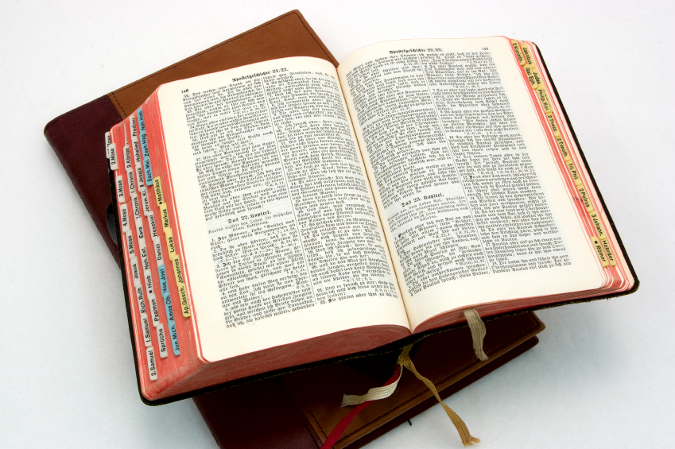
Hear: Romans 10:17
So then faith cometh by hearing, and hearing by the word of God.

Slide 43
Believe: Hebrews 11:6
But without faith it is impossible to please him: for he that cometh to God must believe that he is, and that he is a rewarder of them that diligently seek him.

Slide 44
Repent: Luke 13:3
I tell you, Nay: but, except ye repent, ye shall all likewise perish.

Slide 45
Confess: Matthew 10:32-33
32 Whosoever therefore shall confess me before men, him will I confess also before my Father which is in heaven.
33 But whosoever shall deny me before men, him will I also deny before my Father which is in heaven.

Slide 46
Baptize: Acts 22:16
And now why tarriest thou? arise, and be baptized, and wash away thy sins, calling on the name of the Lord.

